Slide 1
Atmospheric energy budget perspective on clouds-aerosol interactions
Guy Dagan and Philip Stier
Atmospheric, Oceanic and Planetary Physics, Department of Physics, University of Oxford, UK

Slide 2
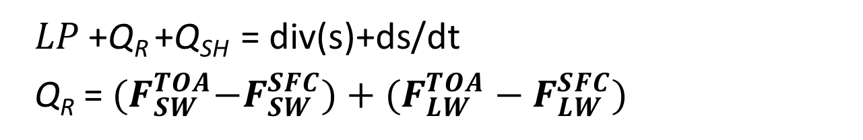
Atmospheric energy budget
𝐿𝑃 +Q_{R} +Q_{SH} = div(s)+ds/dt
Q_{R} = ${(F}_{SW}^{TOA}−F_{SW}^{SFC})+(F_{LW}^{TOA}−F_{LW}^{SFC})$

Slide 3
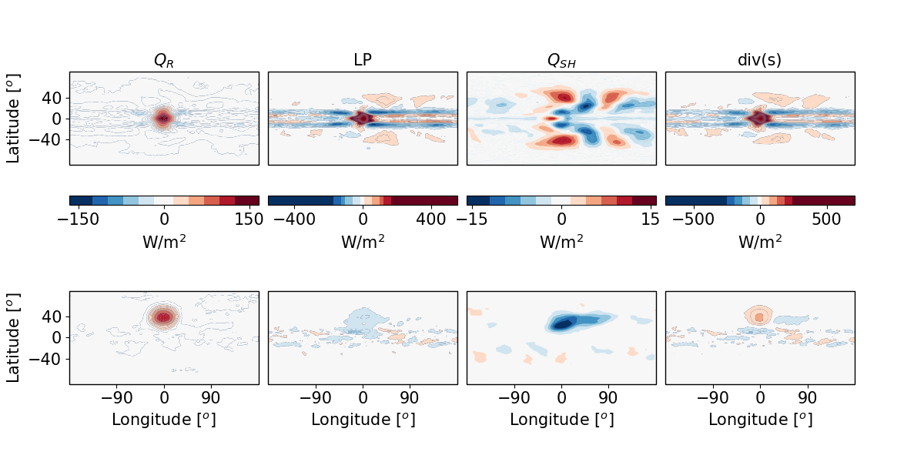
Atmospheric energy budget
What does it is used for?
Aerosol effect on precipitation in global scale simulations
Aerosol effect on precipitation in regional scale simulations

Slide 4
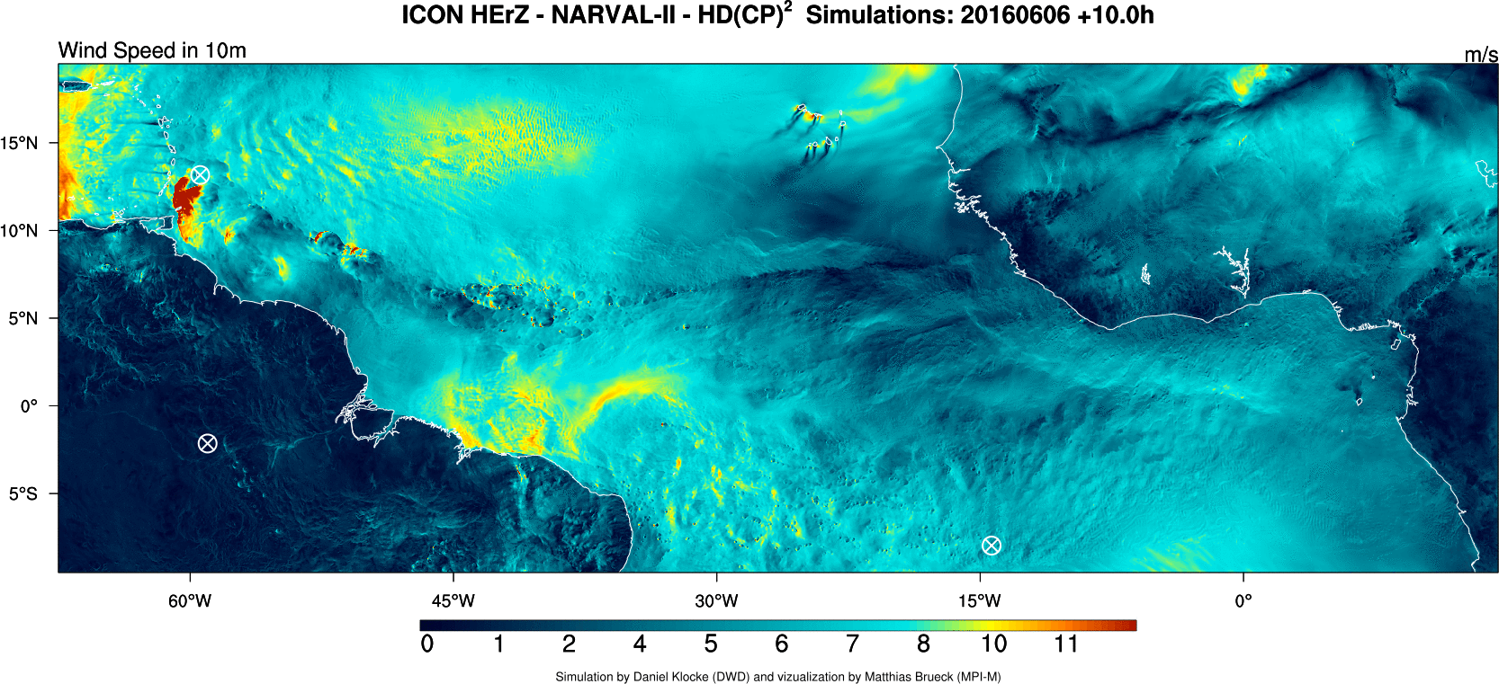
NARVAL 2
https://www.mpimet.mpg.de/en/communication/news/focus-on-overview/do-clouds-make-the-wind-blow-airborne-investigations-of-the-interplay-between-clouds-and-circulation/
Klocke et al., (2017)

Slide 5
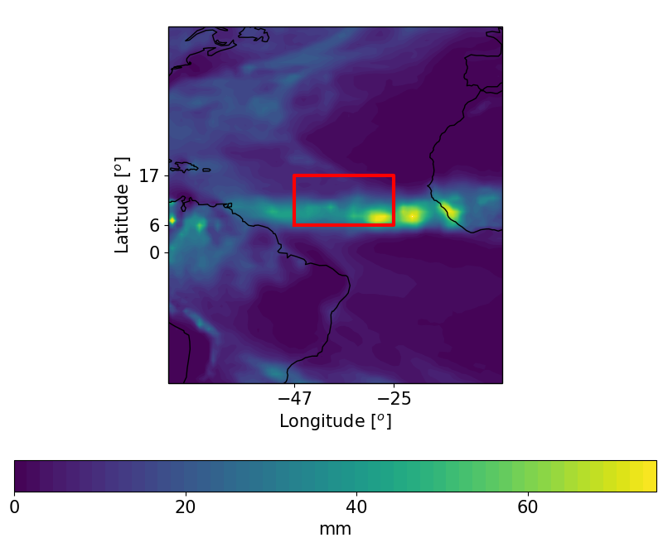
Model and set up
Domain: 22º x 11º
1200 m resolution
75 vertical levels
Two moment bulk microphysics of Seifert and Beheng (2006)
Fixed CDNC:
20, 100, 200 and 500 cm⁻³

Slide 6
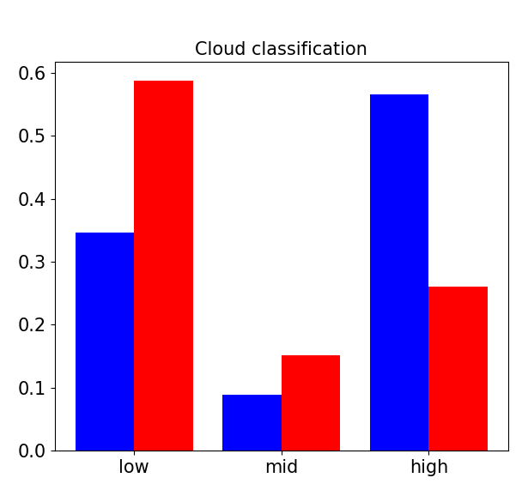
Fraction of different cloud type
10-12/8/2016 – Dominated by shallow clouds
16-18/8/2016 – Dominated by deep clouds
Low: top below 800 mb
Mid: top between 800 and 500 mb
High: top above 500 mb

Slide 7
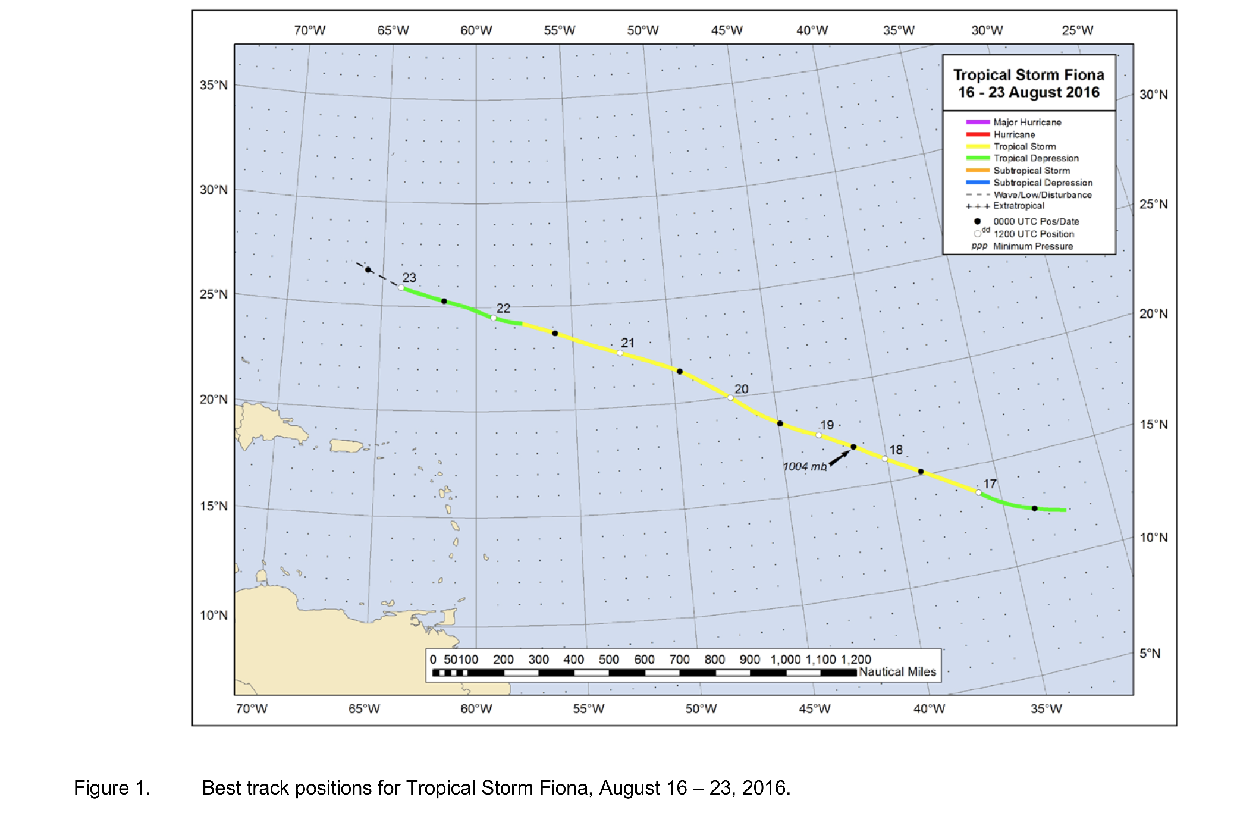
Fiona tropical storm
We simulate the early stages of Fiona tropical storm
Taken from NOAA at: https://www.nhc.noaa.gov/data/tcr/AL062016_Fiona.pdf

Slide 8
16-18/8/2016 – Fiona
Dominated by deep clouds

Slide 9
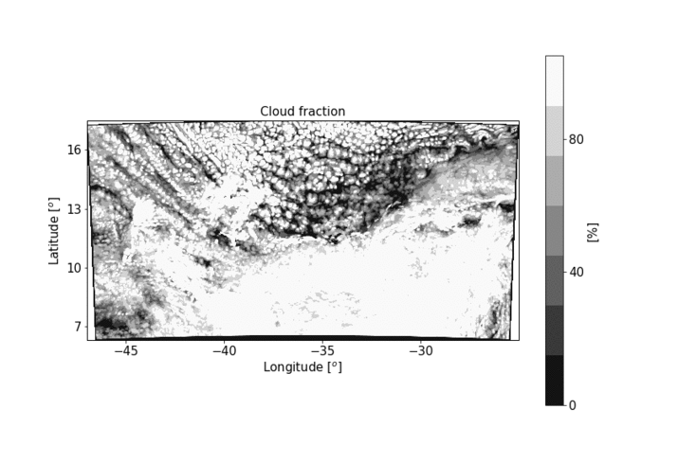
16-18/8/2016 – Fiona

Slide 10
10-12/8/2016
Dominated by shallow clouds

Slide 11
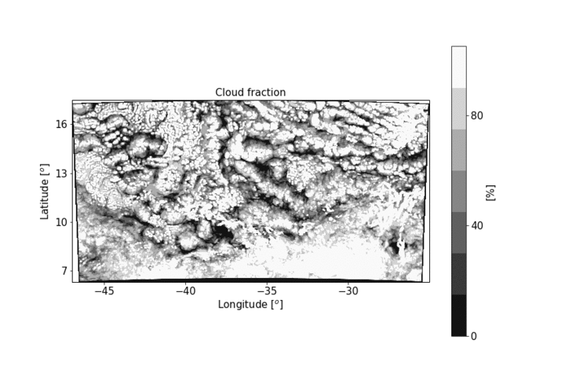
10-12/8/2016

Slide 12
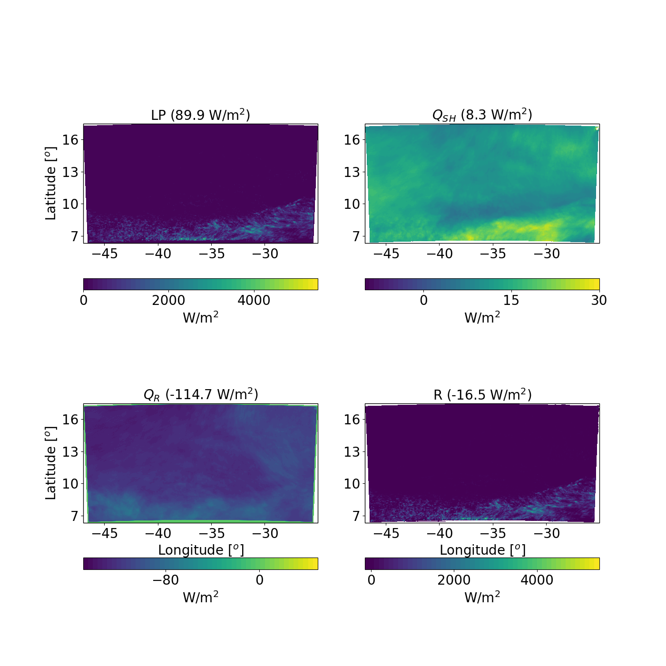
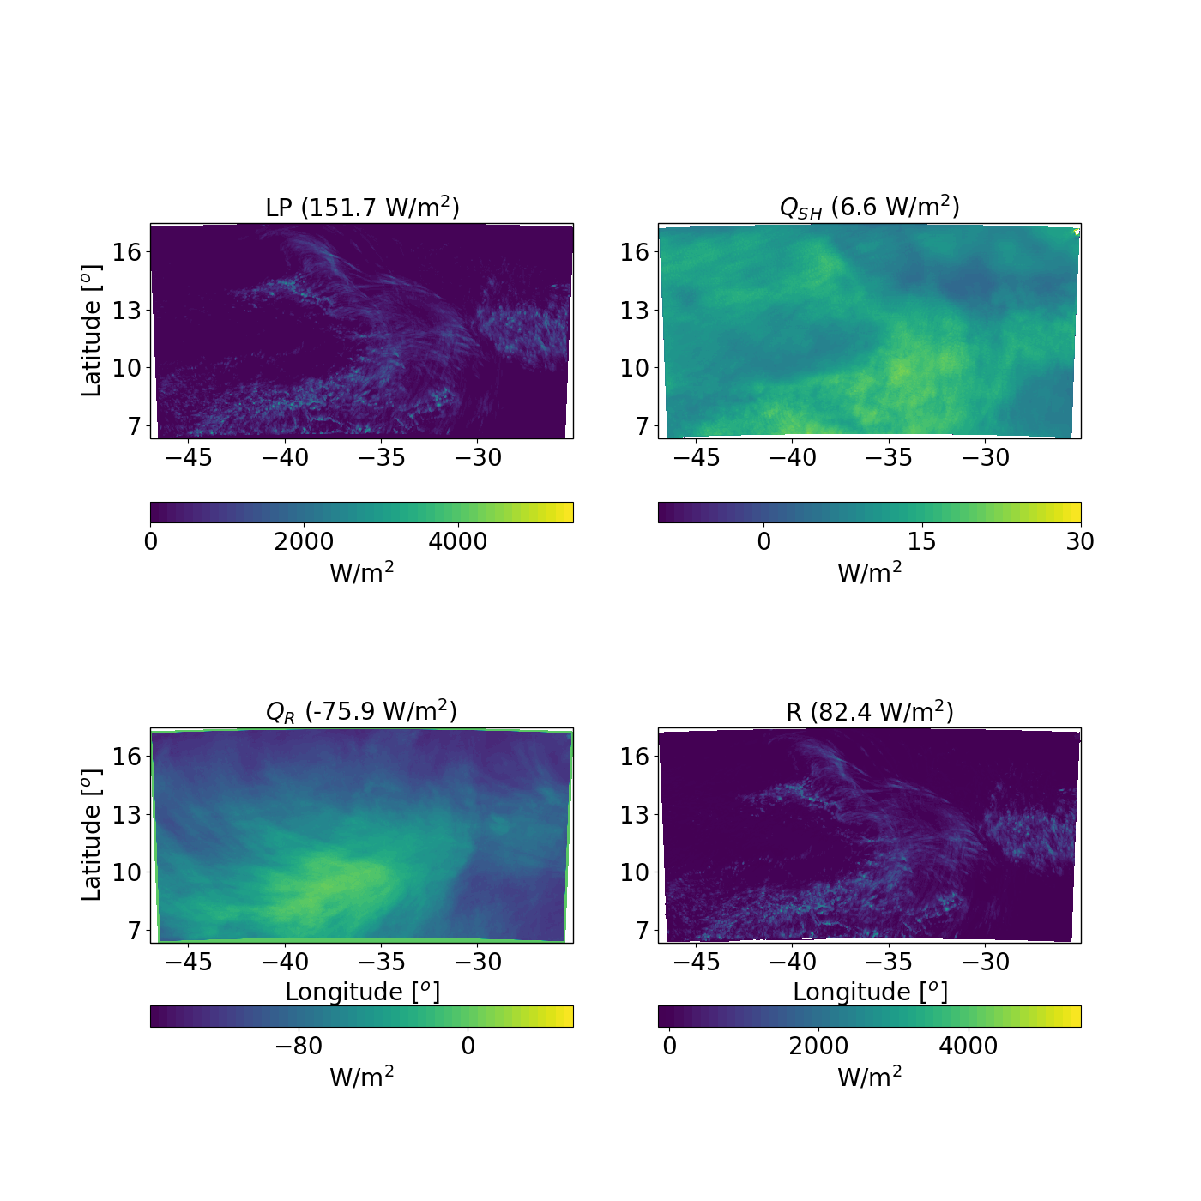
Energy budget
10-12/8/2016 –
Shallow dominated
Radiative cooling dominated
16-18/8/2016 –
Deep dominated
Precipitation warming dominated

Slide 13
Energy budget
Different spatial distribution between LP and Q_{R}
1mm/h = 628 W/m²

Slide 14
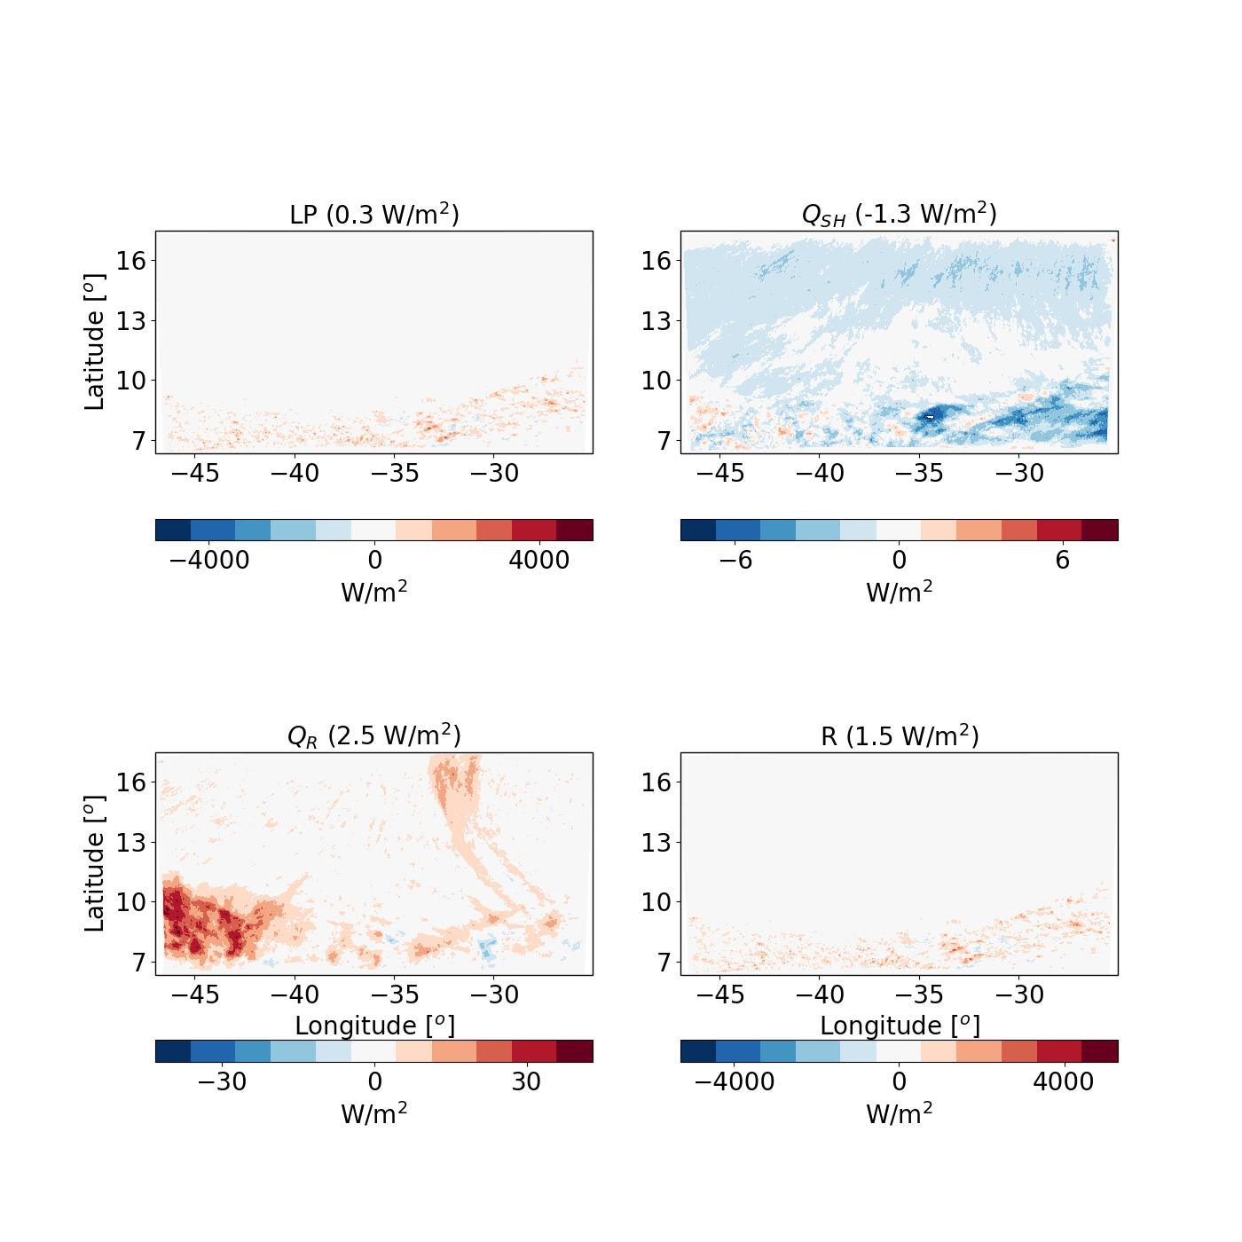
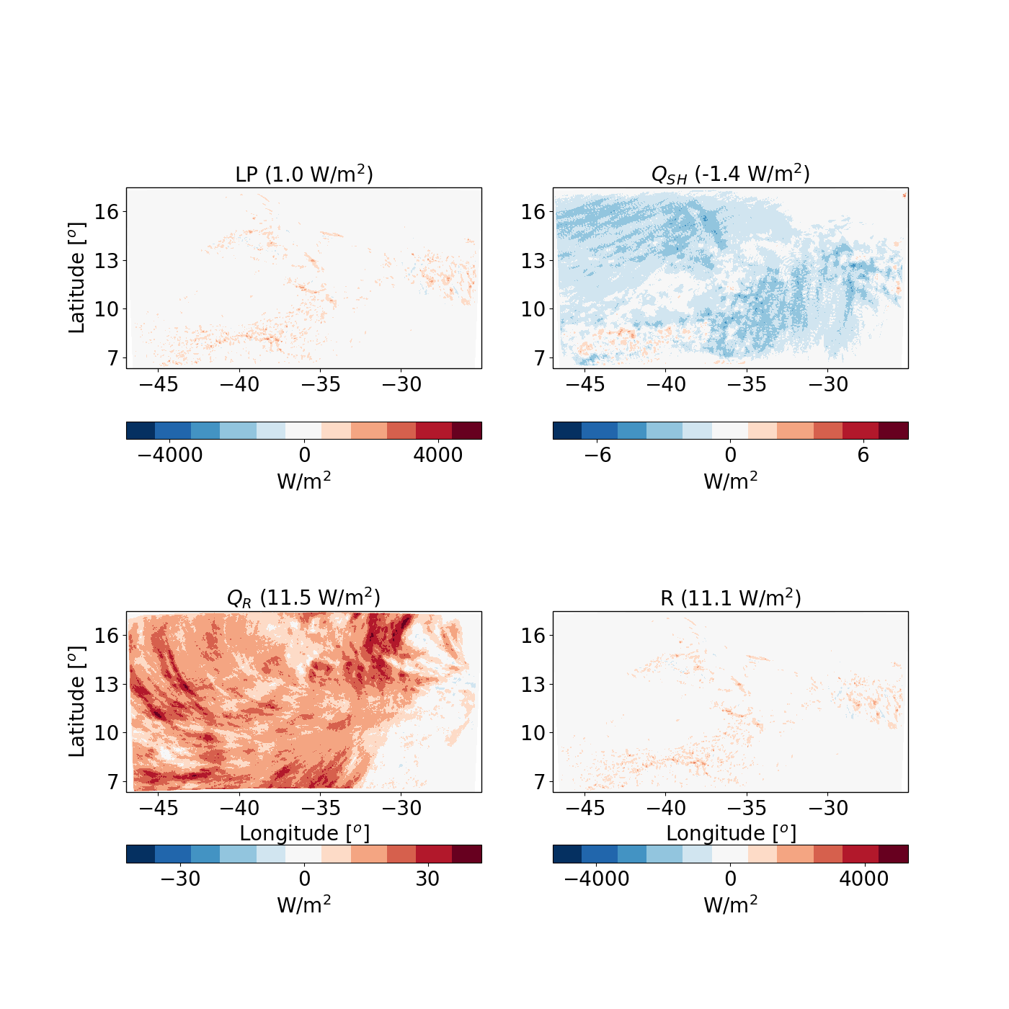
Energy budget – aerosol effect (200-20)
Weak LP change
Decrease sensible heat flux
Radiative warming
Weak LP change
Decrease sensible heat flux
Strong radiative warming

Slide 15
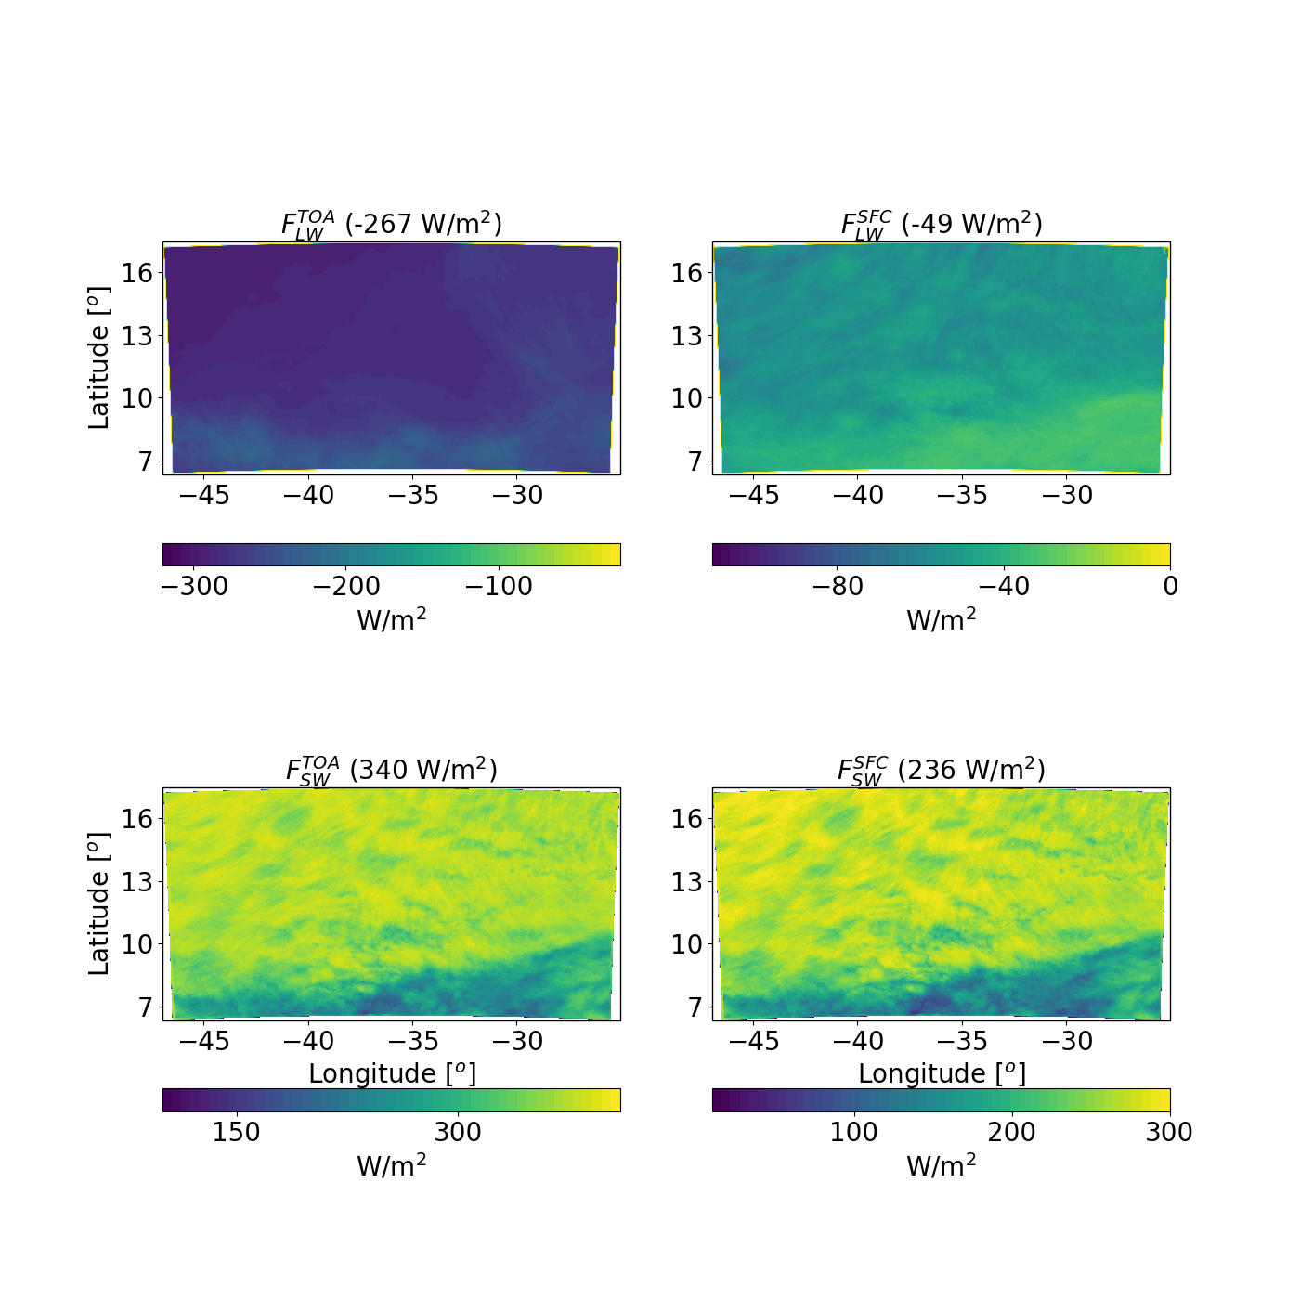
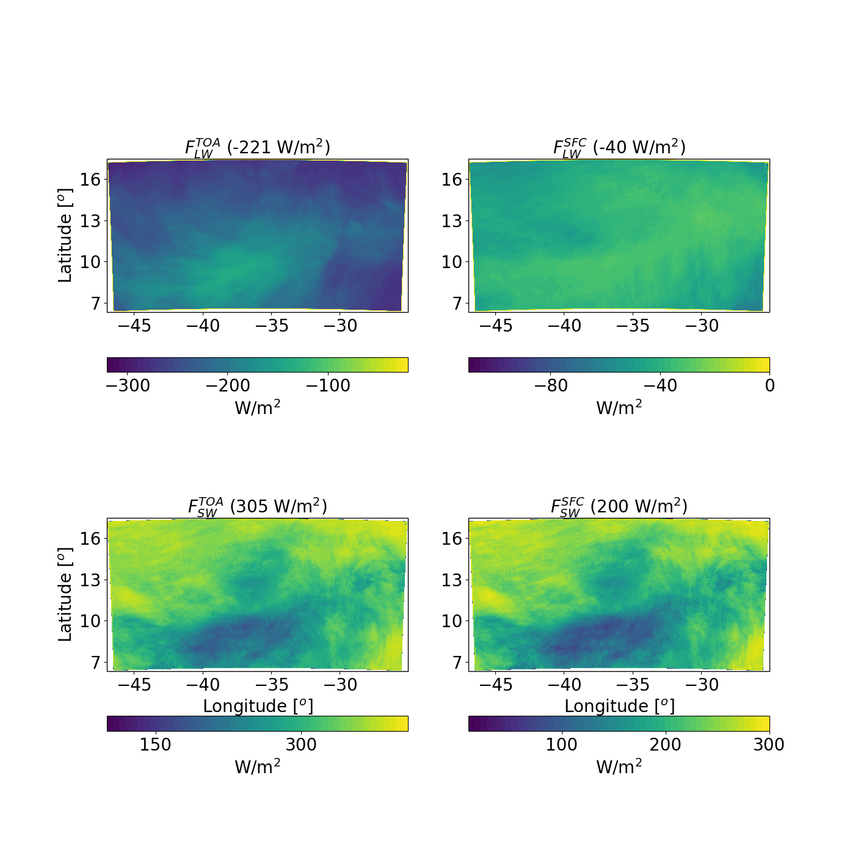
Radiation budget
North-south gradients
Decrease fluxes (opaquer clouds)
Net difference in radiative cooling : - 39 W/m²

Slide 16
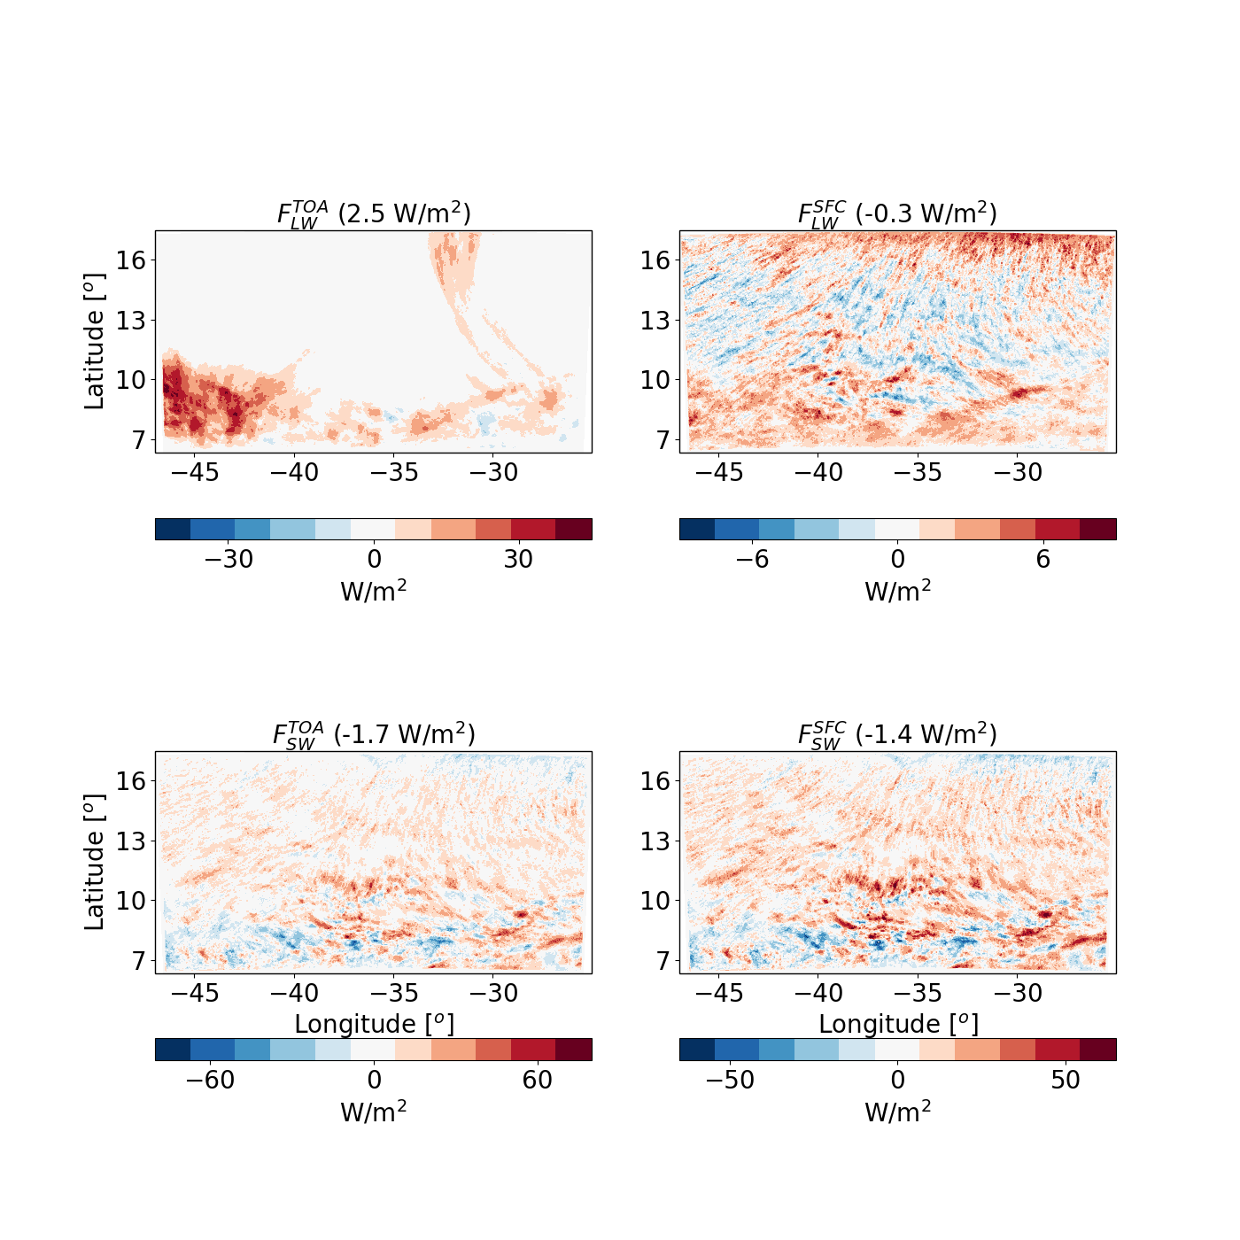
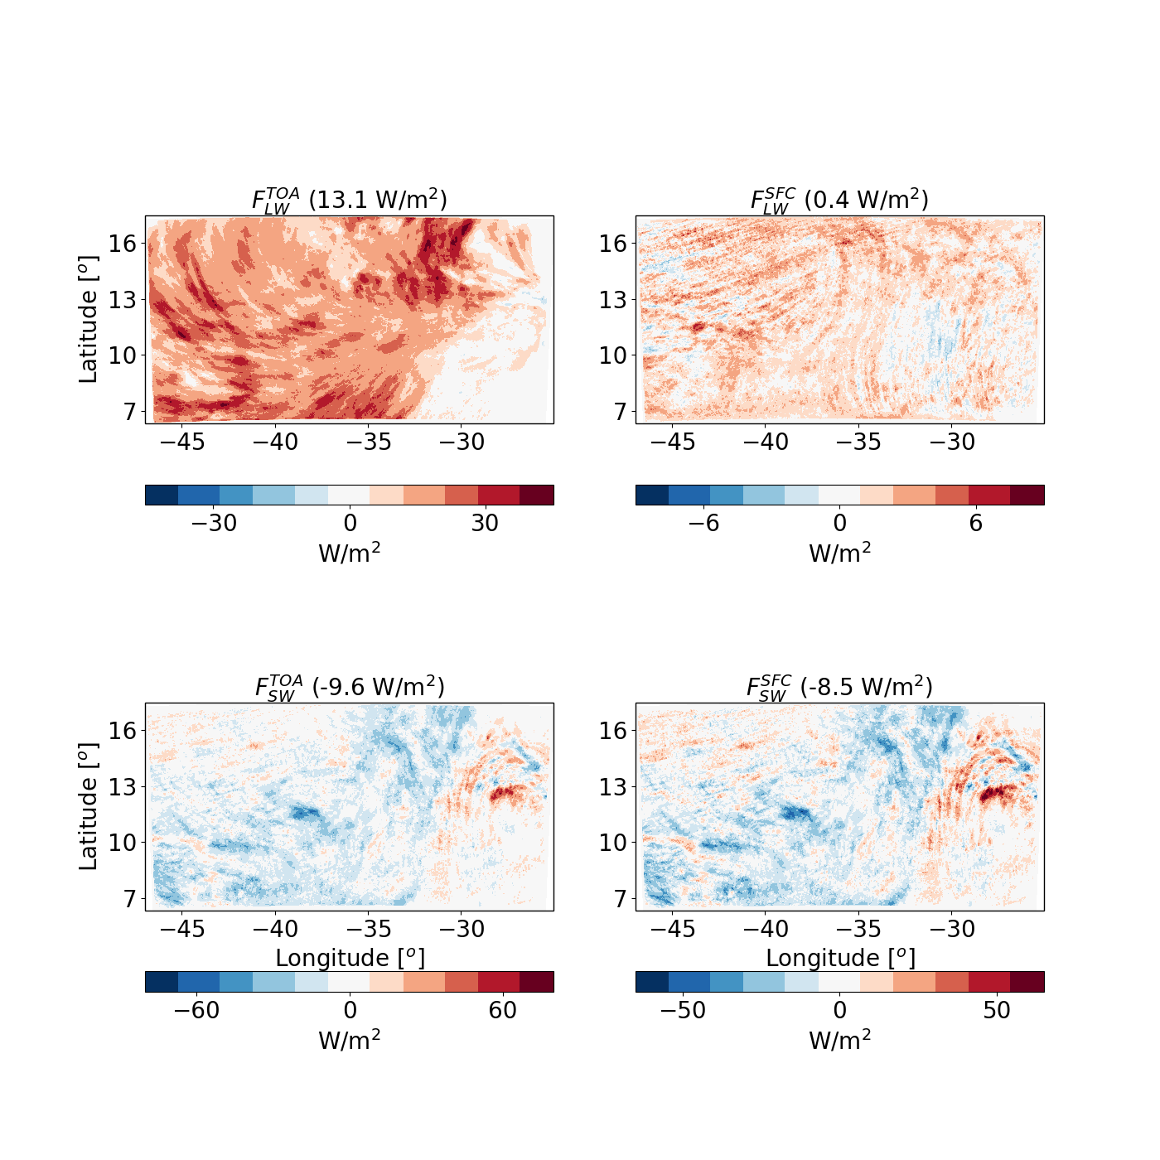
Radiation budget – aerosol effect
In both cases most of the warming comes from reduction in $F_{LW}^{TOA}$

Slide 17
Radiation budget – aerosol effect
The SW changes are substantial but (in terms of the atmospheric energy budget) cancel each other out

Slide 18
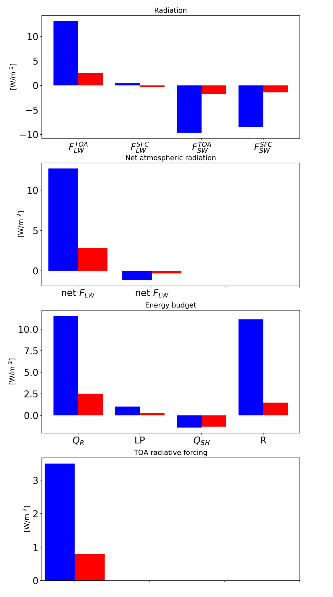
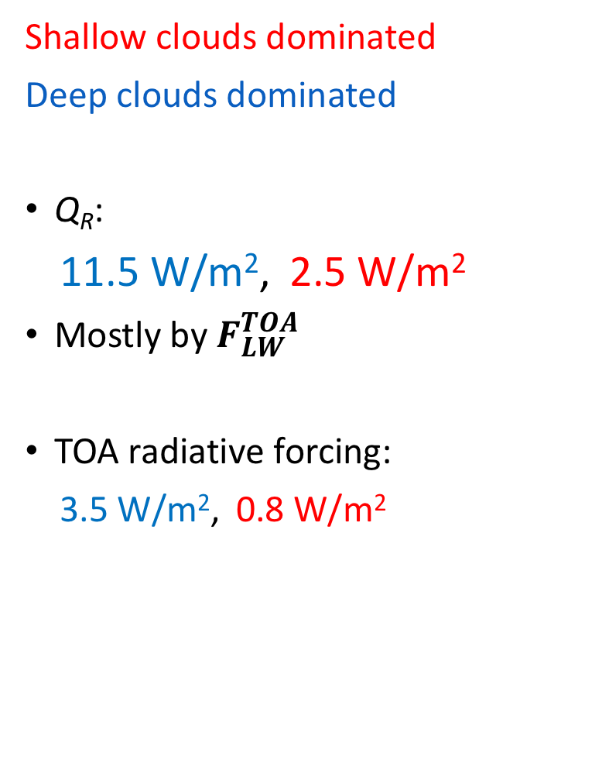
Summary of the energy budget response
Shallow clouds dominated
Deep clouds dominated
Q_{R}:
11.5 W/m², 2.5 W/m²
Mostly by $F_{LW}^{TOA}$
TOA radiative forcing:
3.5 W/m², 0.8 W/m²

Slide 19
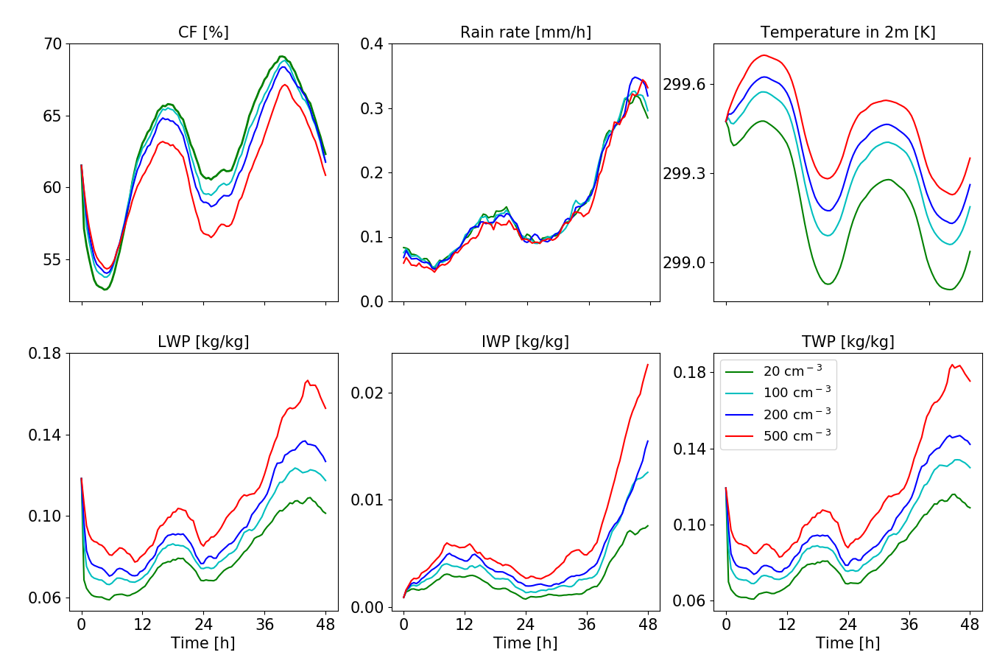
Domain mean properties – shallow dominated case
Decrease in CF
No effect on rain rate
Increase in near surface temperature

Slide 20
Domain mean properties – shallow dominated case
Increase in LWP
Increase in IWP
Hence, also increase in TWP

Slide 21
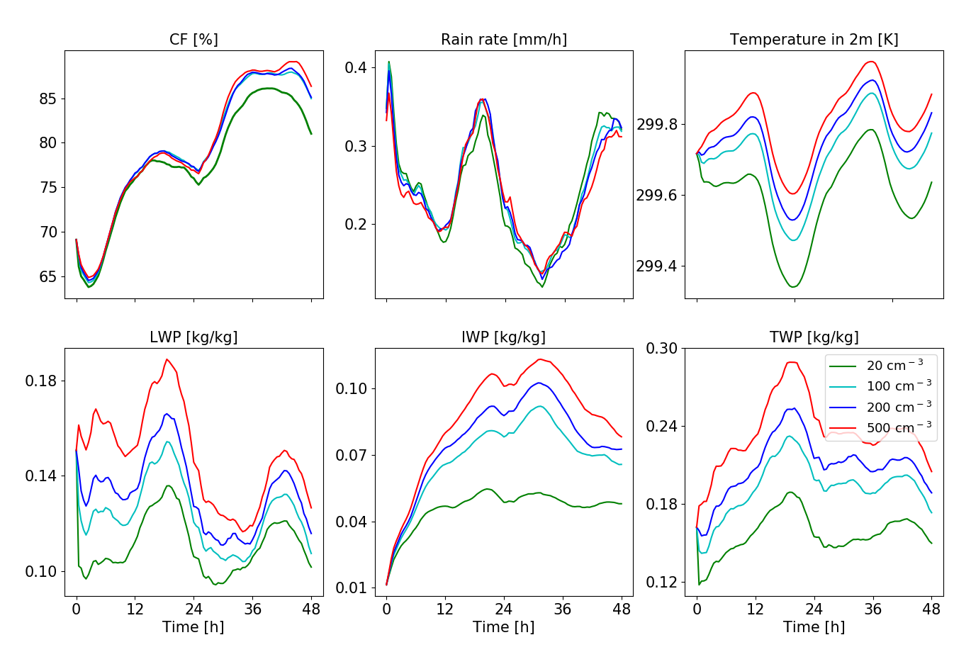
Domain mean properties – deep dominated case
Increase in CF (X)
No effect on rain rate (✓)
Increase in near surface temperature (✓)

Slide 22
Domain mean properties – deep dominated case
Increase in LWP (✓)
Increase in IWP (✓)
Hence, also increase in TWP (✓)

Slide 23
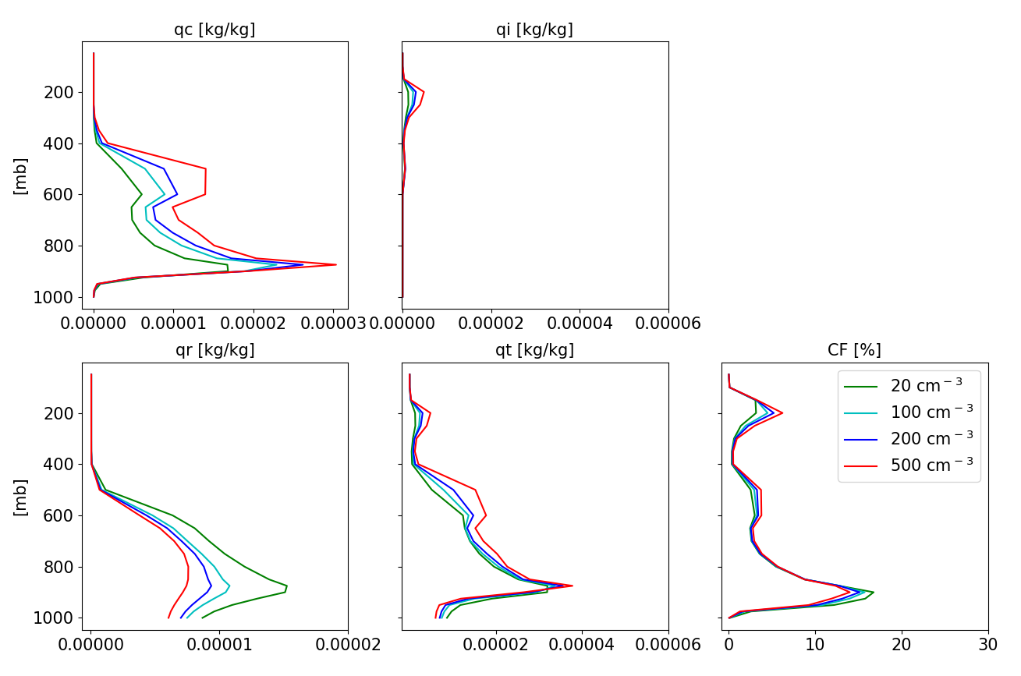
Mean vertical profiles – Shallow dominated case
Decrease in low CF, increase in high CF
Increase in water amount at the mid and upper troposphere

Slide 24
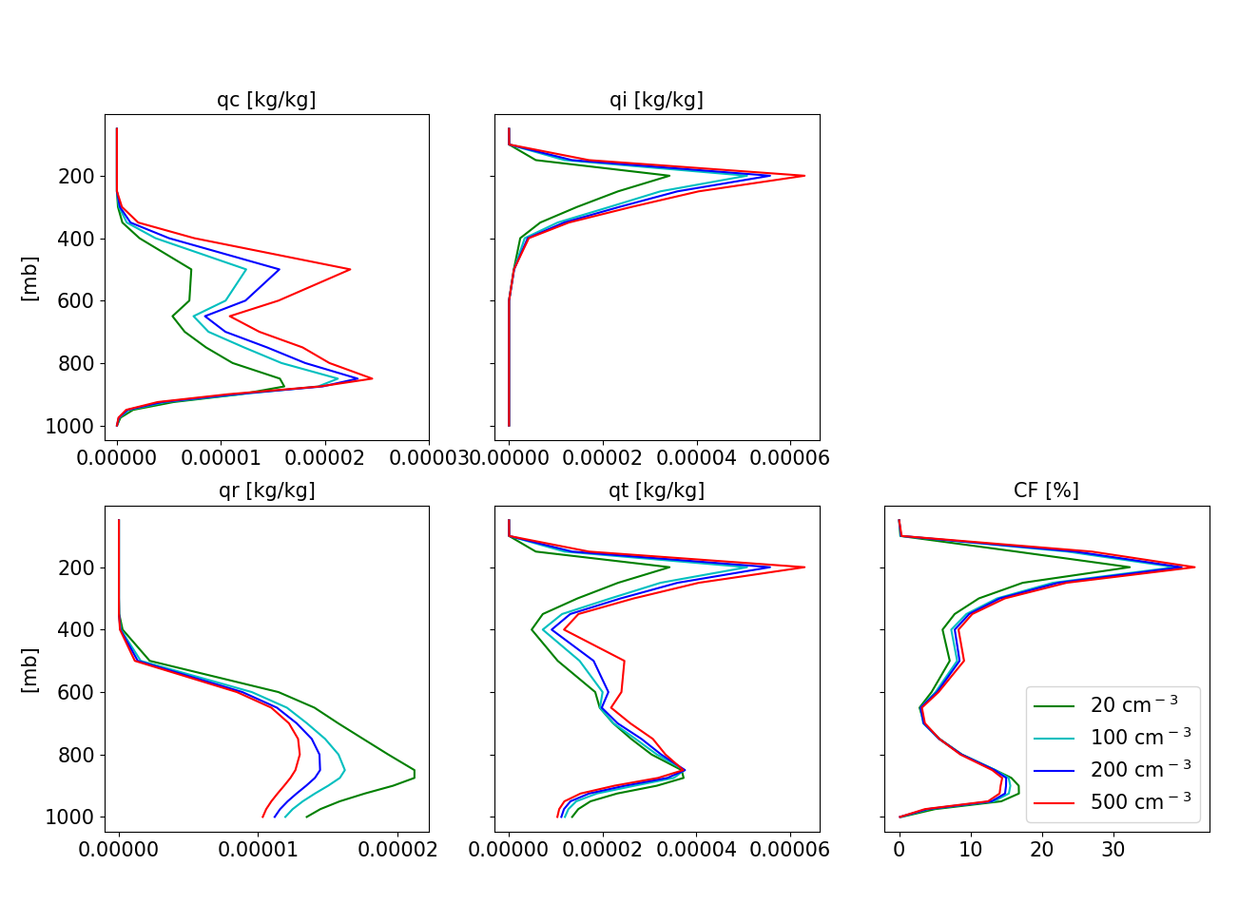
Mean vertical profiles – deep dominated case
Decrease in low CF, increase in high CF (✓)
Increase in water amount at the mid and upper troposphere (✓)

Slide 25
Mean vertical profiles – deep dominated case
Larger increase in ice content at the upper troposphere

Slide 26
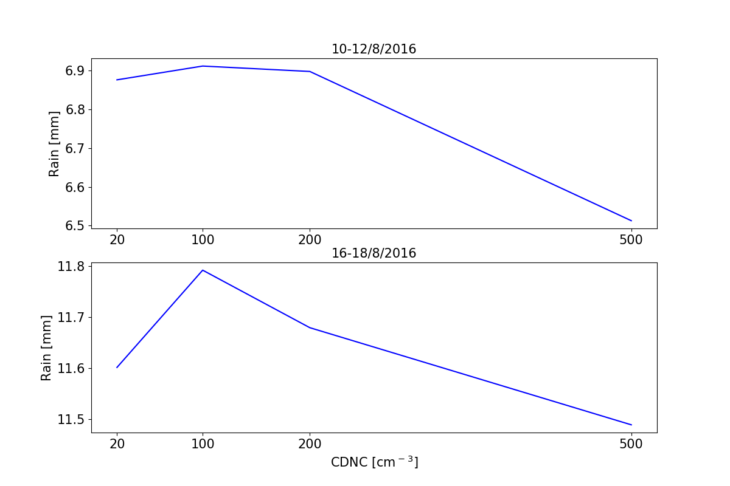
Total rain amount
Small changes in rain can make large changes to the energy budget
1 mm/h = 628 W/m²
0.2 mm/48h = 2.6 W/m²

Slide 27
Summary
The atmospheric energy budget can be used to constrain aerosol effect on precipitation
In this case it is applied to reginal scale simulations using the ICON model

Slide 28
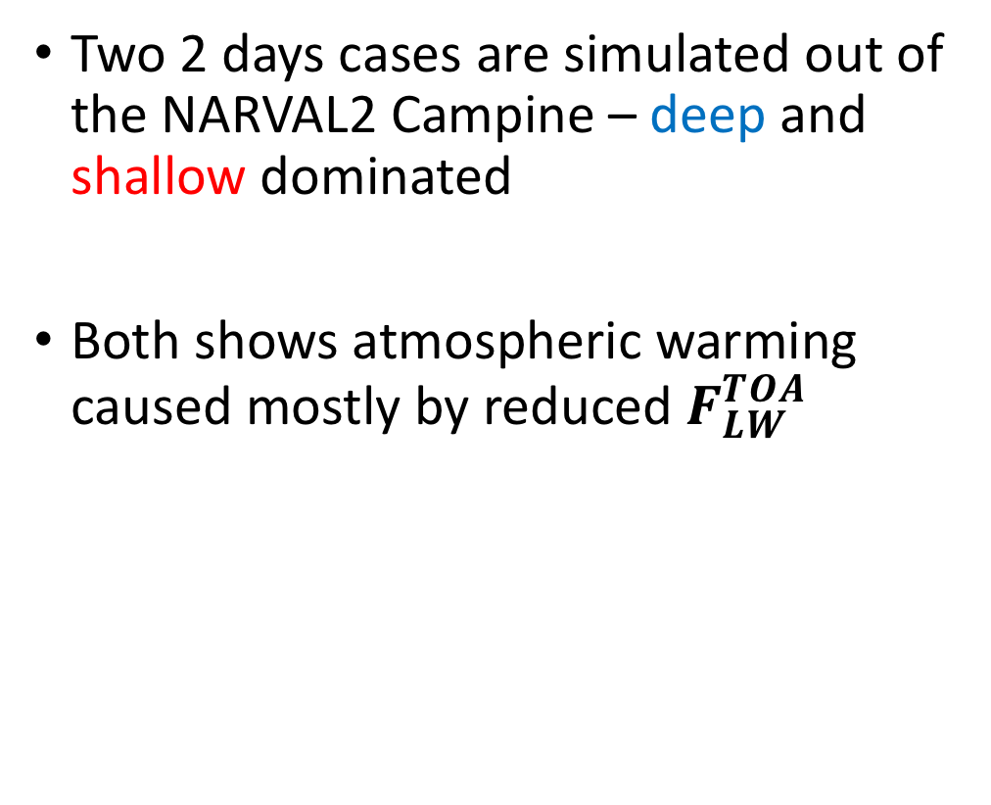
Summary
Two 2 days cases are simulated out of the NARVAL2 Campine – deep and shallow dominated
Both shows atmospheric warming caused mostly by reduced $F_{LW}^{TOA}$

Slide 29
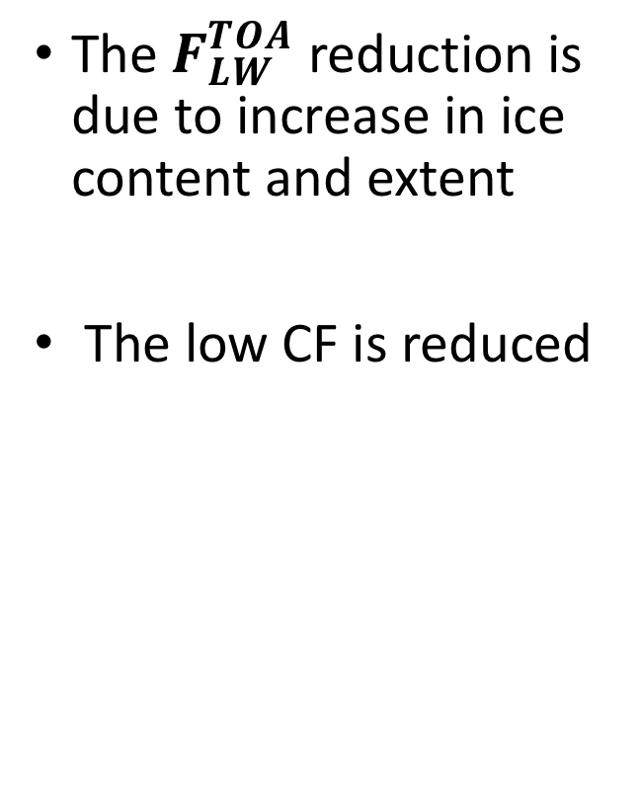
Summary
The $F_{LW}^{TOA}$reduction is due to increase in ice content and extent
The low CF is reduced

Slide 30
Thank you

